Slide 1

Quick Start Guide

Slide 2
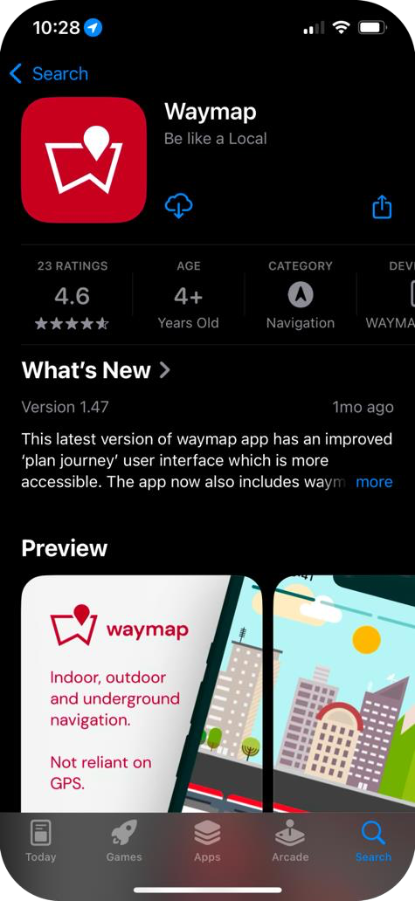
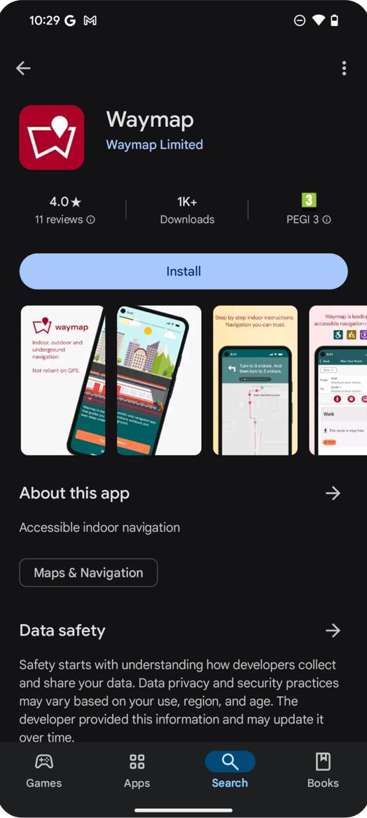
Downloading Waymap
Waymap is available to download from the iOS App Store and the Android Google Play Store.
How to download:
Open the App Store or Google Play Store
Search for "Waymap"
Tap Download and wait for the app to install
App Store
Google Play
2

Slide 3
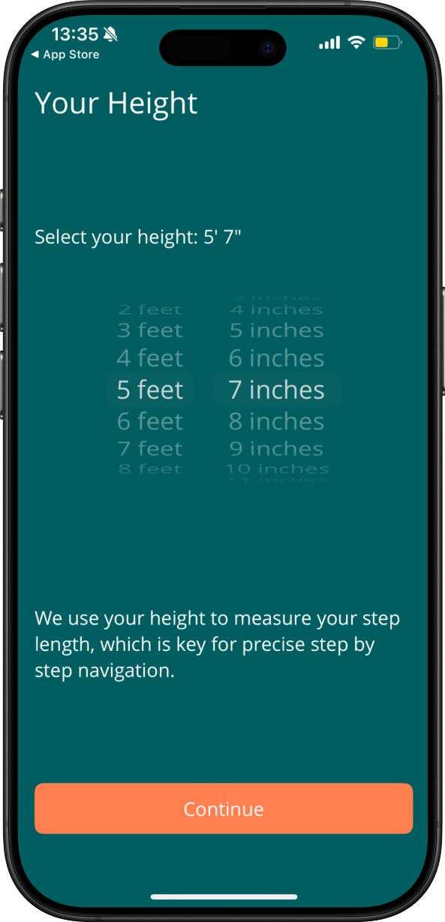
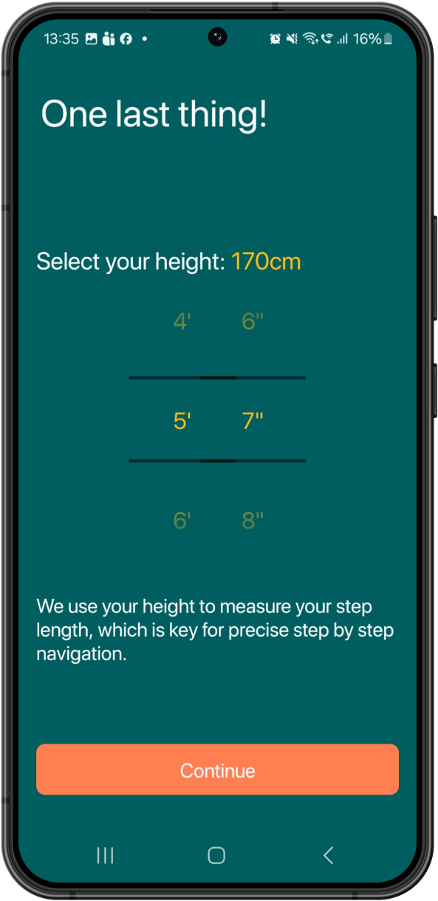
Set your Height
During onboarding we will request that you set your height.
This helps us to estimate your step length which is vital for accurate step by step navigation.
3

Slide 4
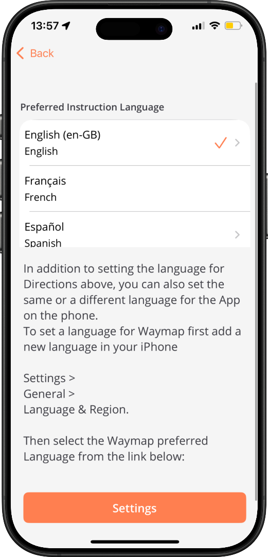
Language Preferences
Waymap offers English (recommended), Chinese, Malay, German, Spanish and more languages, for its navigation instructions.
4

Slide 5
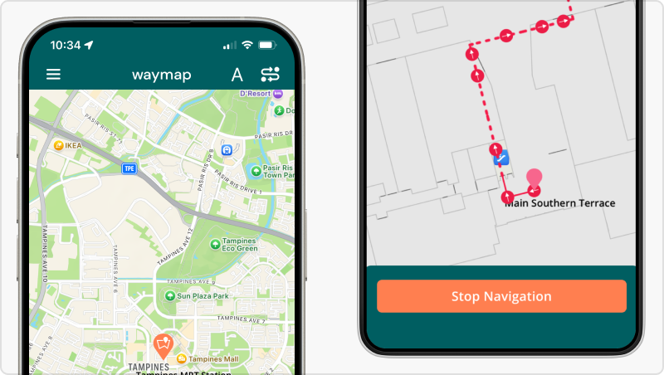
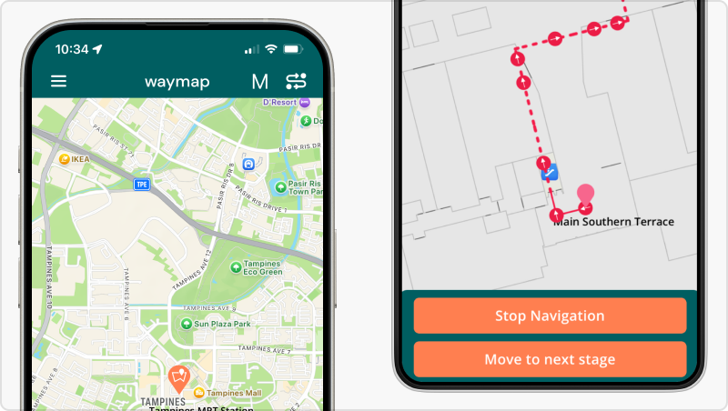
Navigation Modes
There are two navigation modes, Automatic and Manual. Automatic is selected by default. Change by selecting either ‘A’ or ‘M’. Manual mode offers turn by turn navigation for wheelchair users. We recommend you use Automatic mode for a typical Waymap navigation experience.
Automatic Mode
Manual Mode
In Automatic mode, you’ll automatically progress through the route’s instructions as we keep track of your progress.
In Manual Mode, you can manually swipe through the route instructions.
5

Slide 6
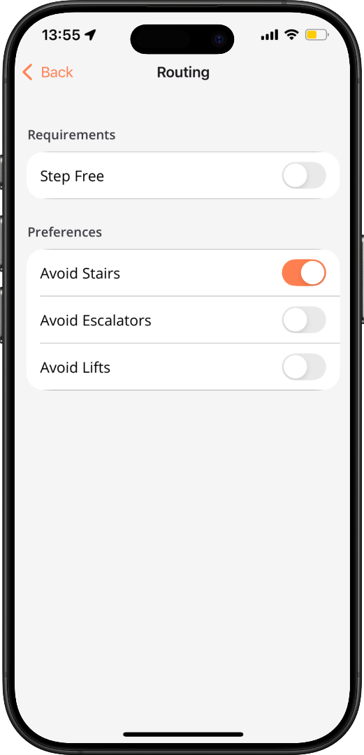
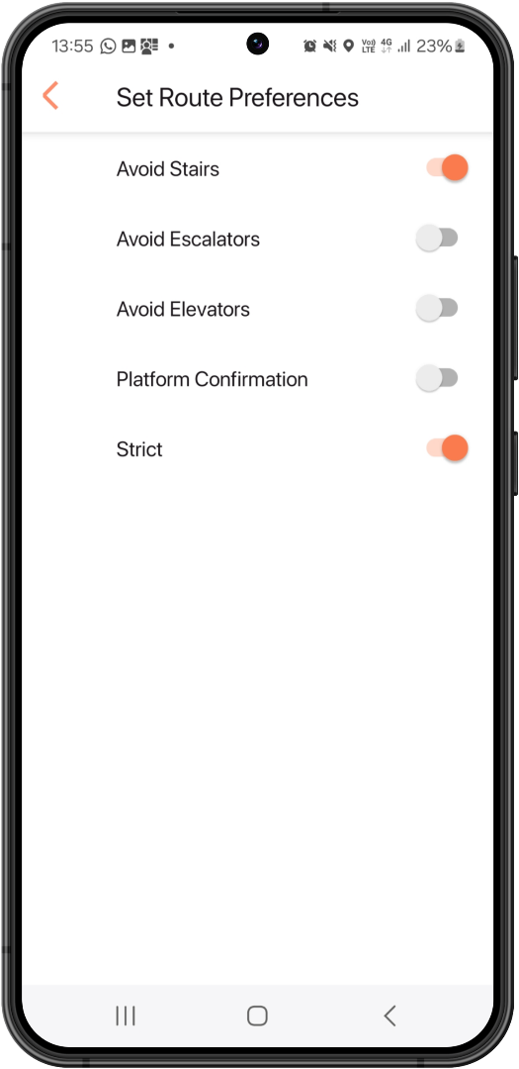
Routing Preferences
Menu > Settings > Routing Requirements
Waymap allows you to choose the type of route that works for you.
Step free - designed for wheelchair or mobility device users.
Avoid stairs - Avoids stairs where possible but allows escalators.
Avoid lifts - Prioritises routes that utilise escalators and stairs
6

Slide 7
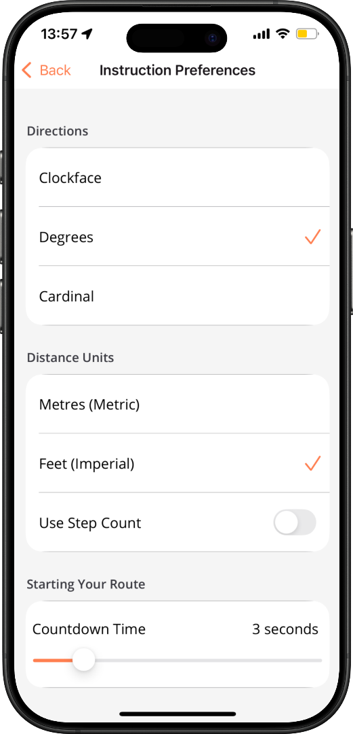
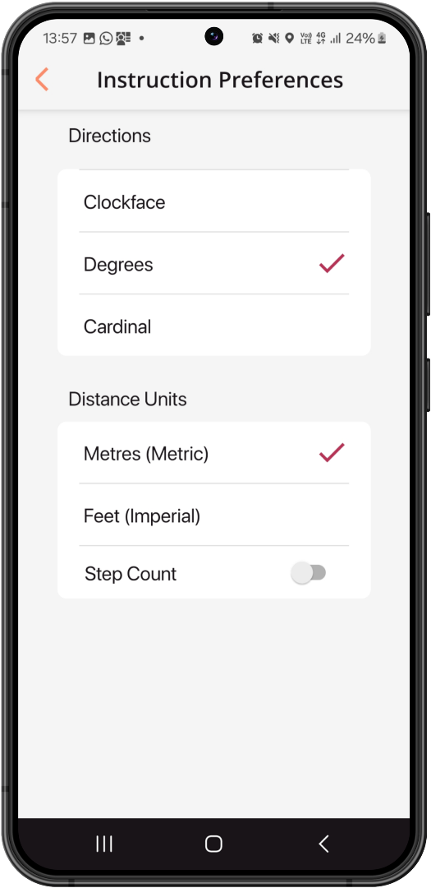
Instructions Preferences
Menu > Settings > Instruction Preferences Waymap allows users to customise the way they receive instructions during navigation. This includes: Use step count - Users an estimated step count instead of units (Metres/Feet) during navigation. (Not recommended). Countdown timer - Designed to give users time to place the phone in a pocket before navigation begins.
7

Slide 8
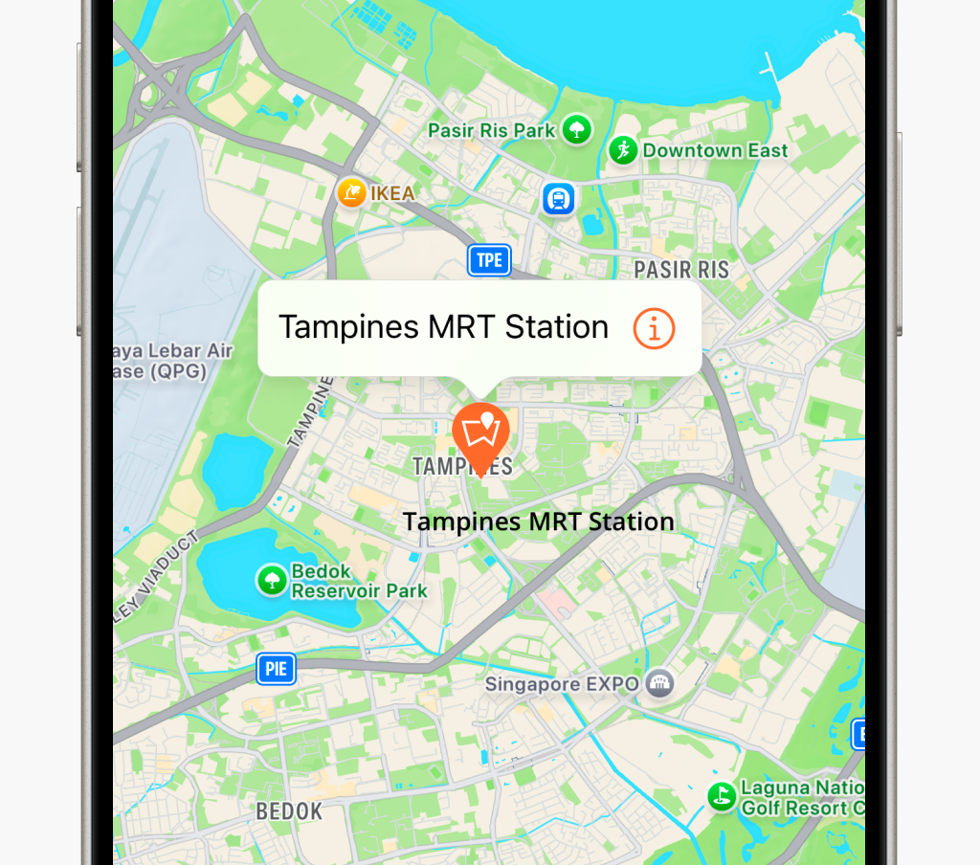
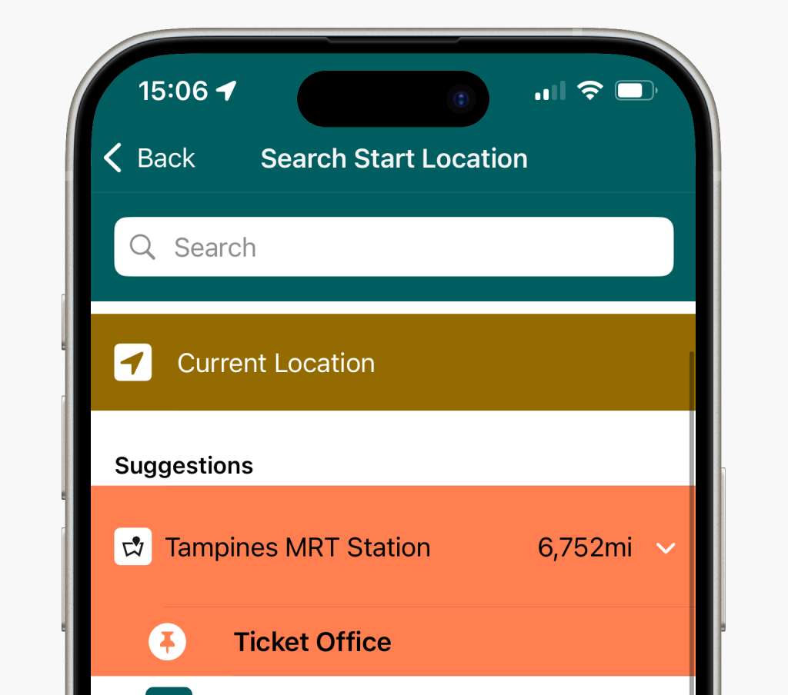
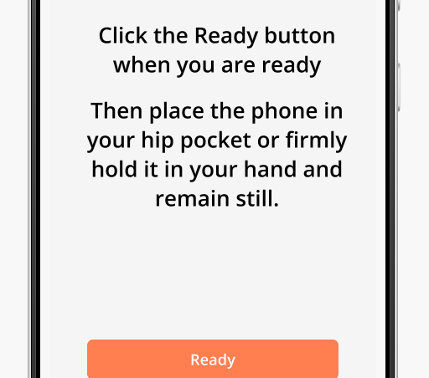
Planning a Journey
We recommend you add Waymap venues to your favourites/suggestions to make them easier to find. You can create a route by selecting ‘Plan Journey’ from the home screen.
Add to Favourites
Set To and From
Initiate Journey
This will help you find locations that matter to you.
Choose a start and end destination from the list and search functions. Start can be localized, see next slide
When you’re ready, tap ‘Go’.
Follow the on-screen prompts, with your device in your pocket or in front of you.

Slide 9
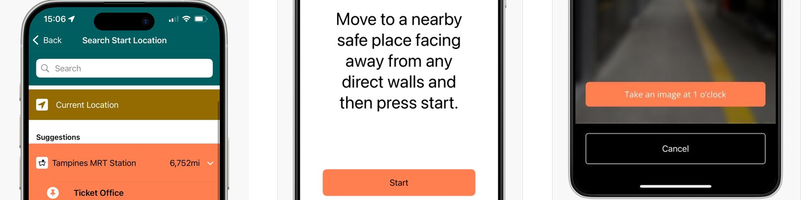
Locating yourself with the camera
Select ‘Current Location’
Follow on-screen instructions
Capture three images
When selecting your start location choose the ‘Current Location’ option
To ensure a successful VPS experience face away from any direct walls.
Take three images at the angles instructed
9

Slide 10
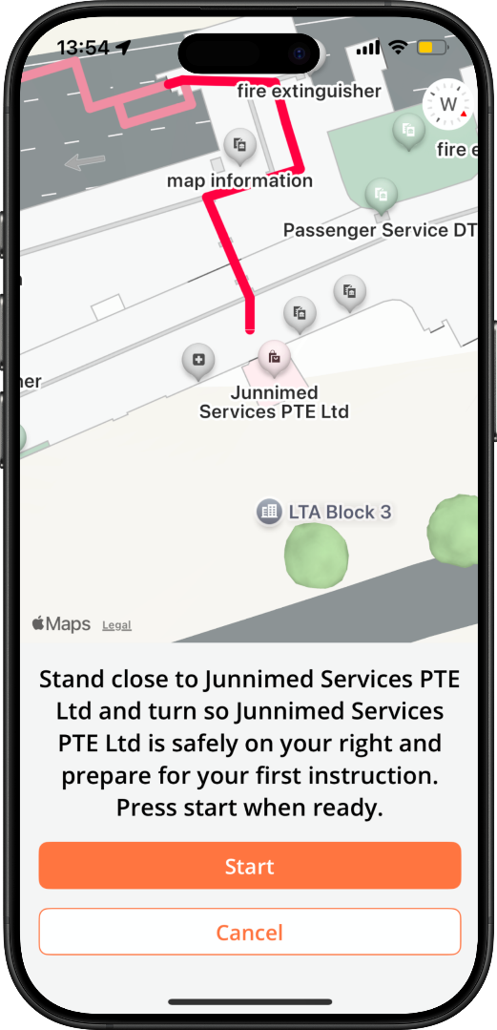
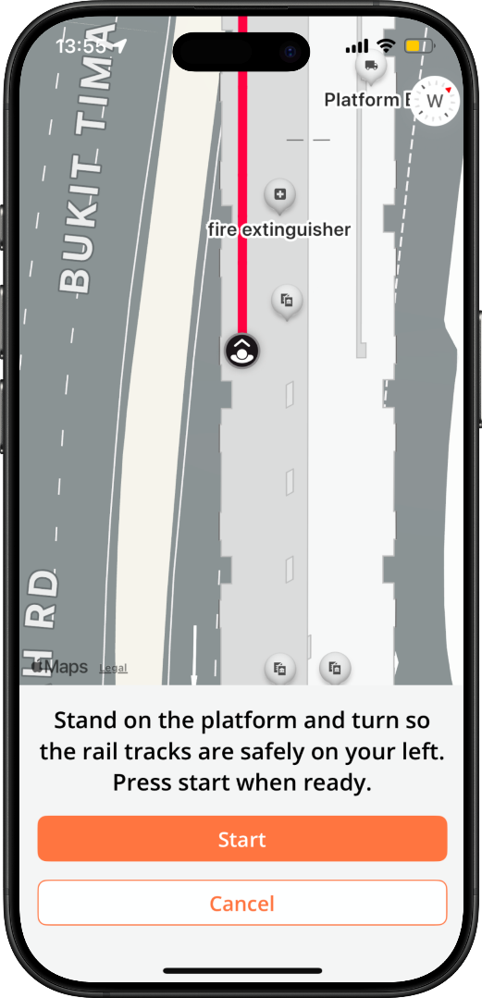

Journey Start
When you begin your journey, the first instruction will be an orientation instruction to ensure that you are standing in the correct start location and facing the correct direction BEFORE you begin.
If the instruction asks you to “Stand close to [Location] with your back towards [Location].”, then orient yourself with the location behind you before starting. If the instruction asks you to “Turn so [Location] is on your right”, then orient yourself with the location on your right.
Waymap's tracking relies on the user following this instruction correctly, so please do pay attention to this very important starting instruction.
10

Slide 11
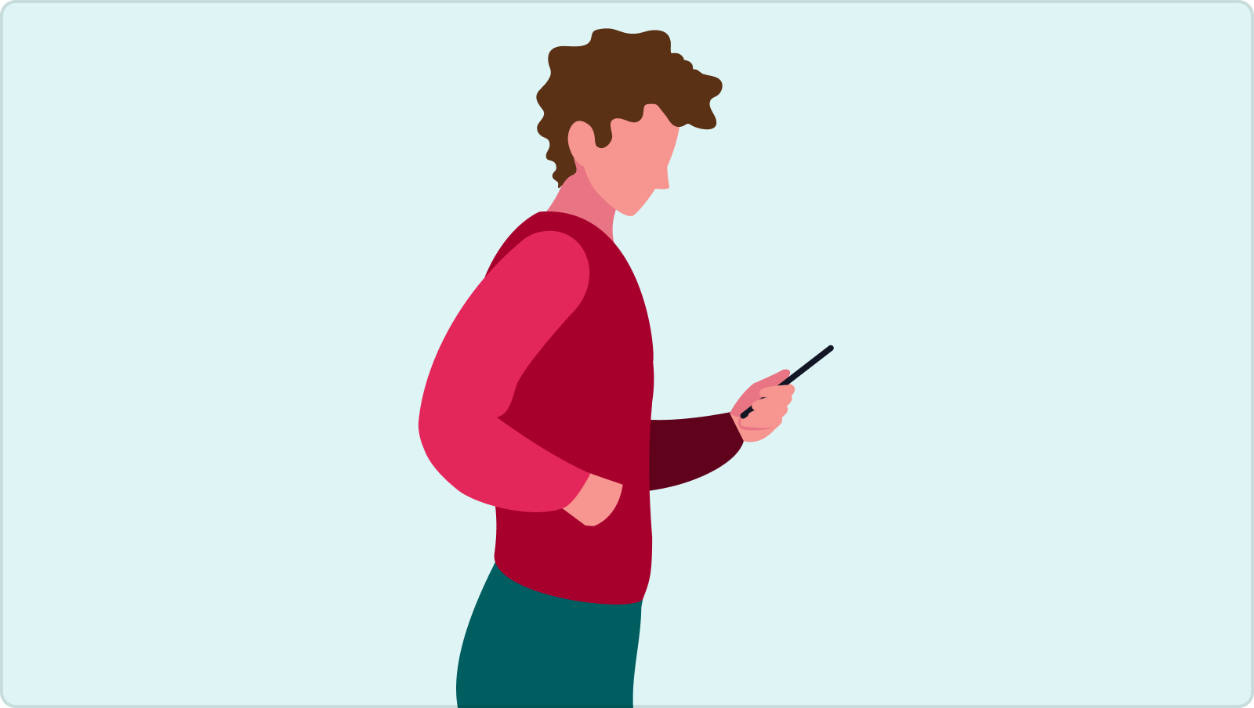

Using Waymap
Waymap offers users the choice between two distinct carry styles for their mobile device while utilising the app: Phone in Pocket and Phone in Hand.
To ensure optimal performance, avoid frequently switching the phone between your pocket and hand—choose the option that works best for you and stick with it throughout your journey.
Phone in hand
Phone in pocket
Hold your phone steady, and out in front of you during navigation. You can follow the on-screen instructions as well as follow your progress on the map.
You can navigate with your phone in your pocket. Instructions will be spoken. We recommend you use headphones.
11

Slide 12
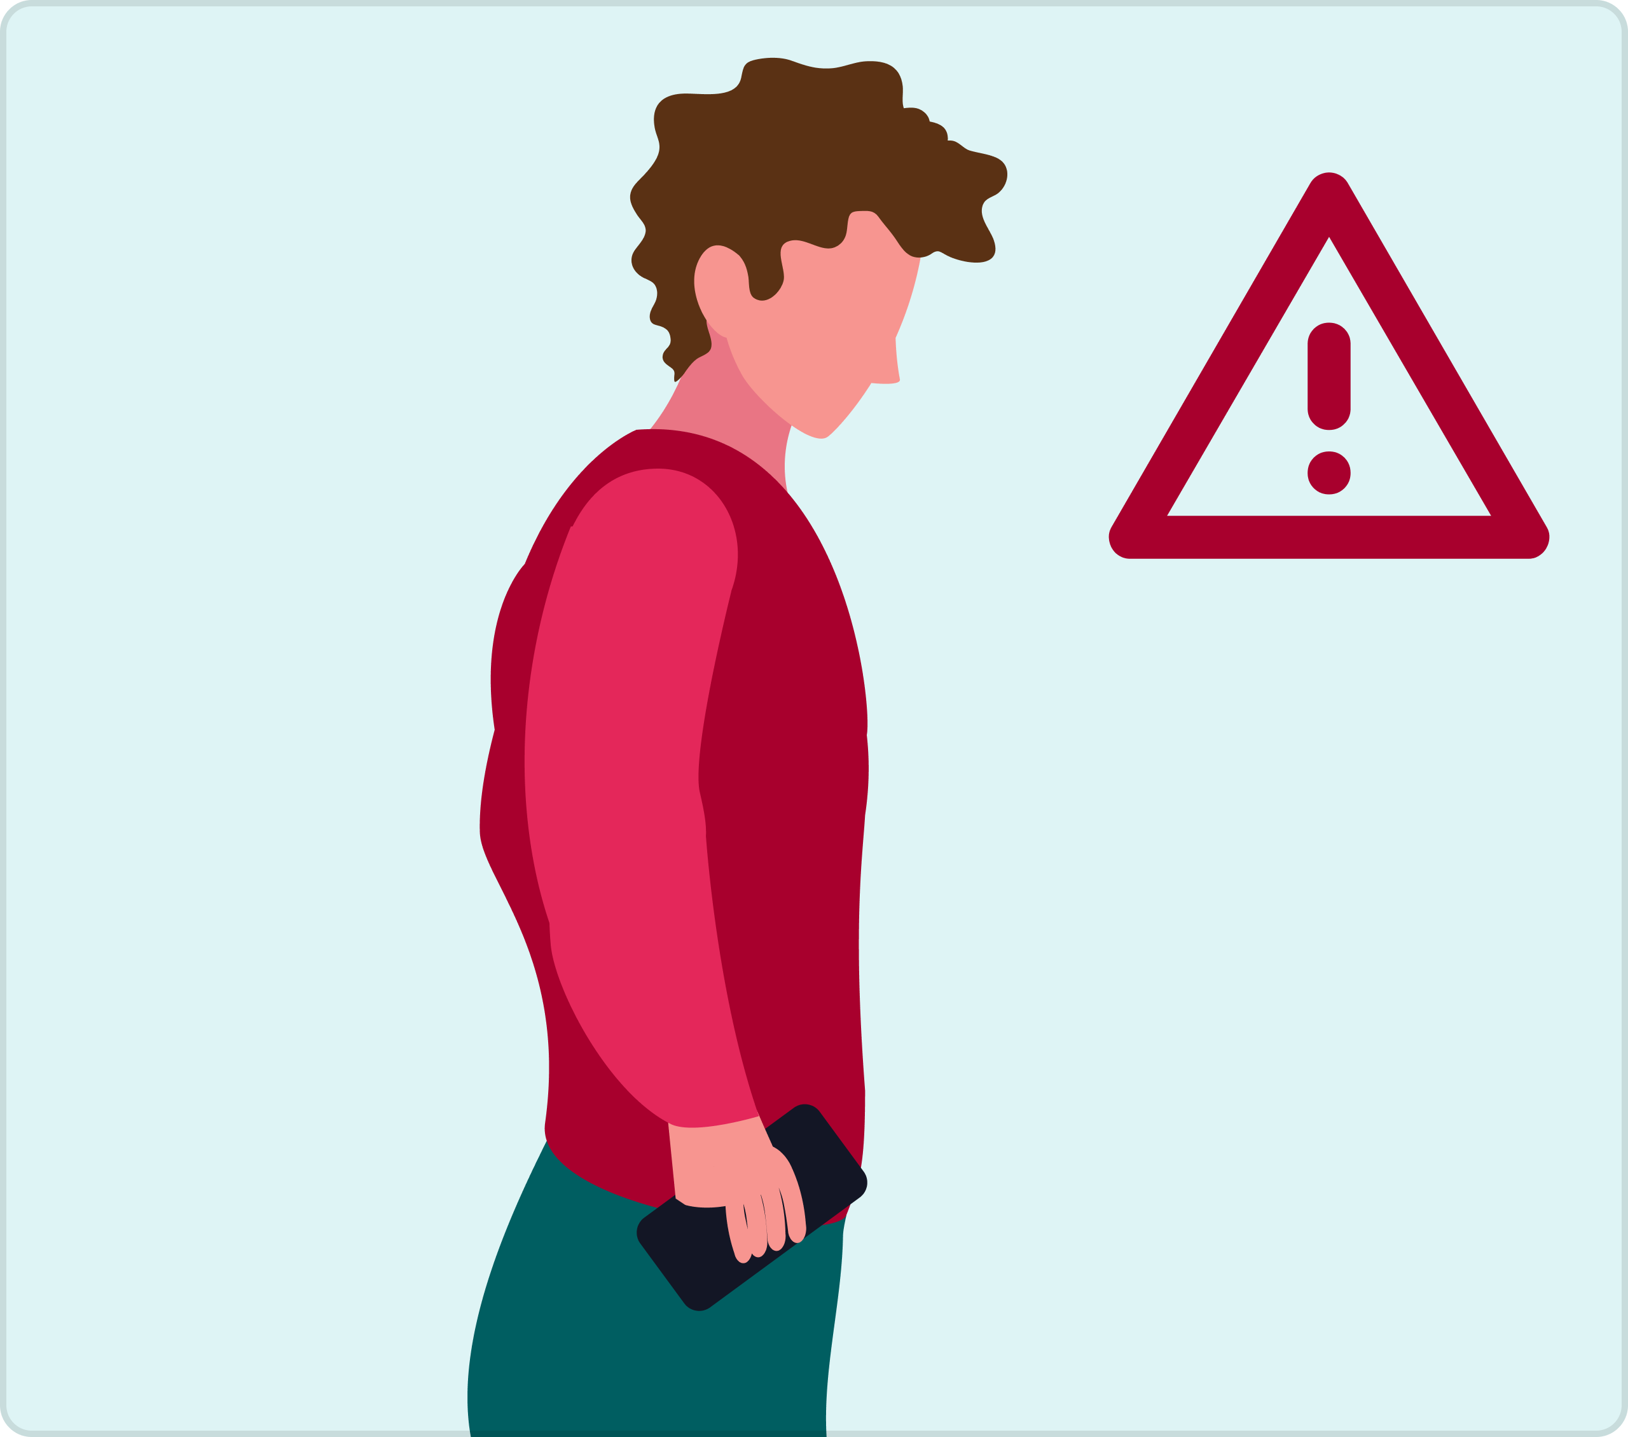
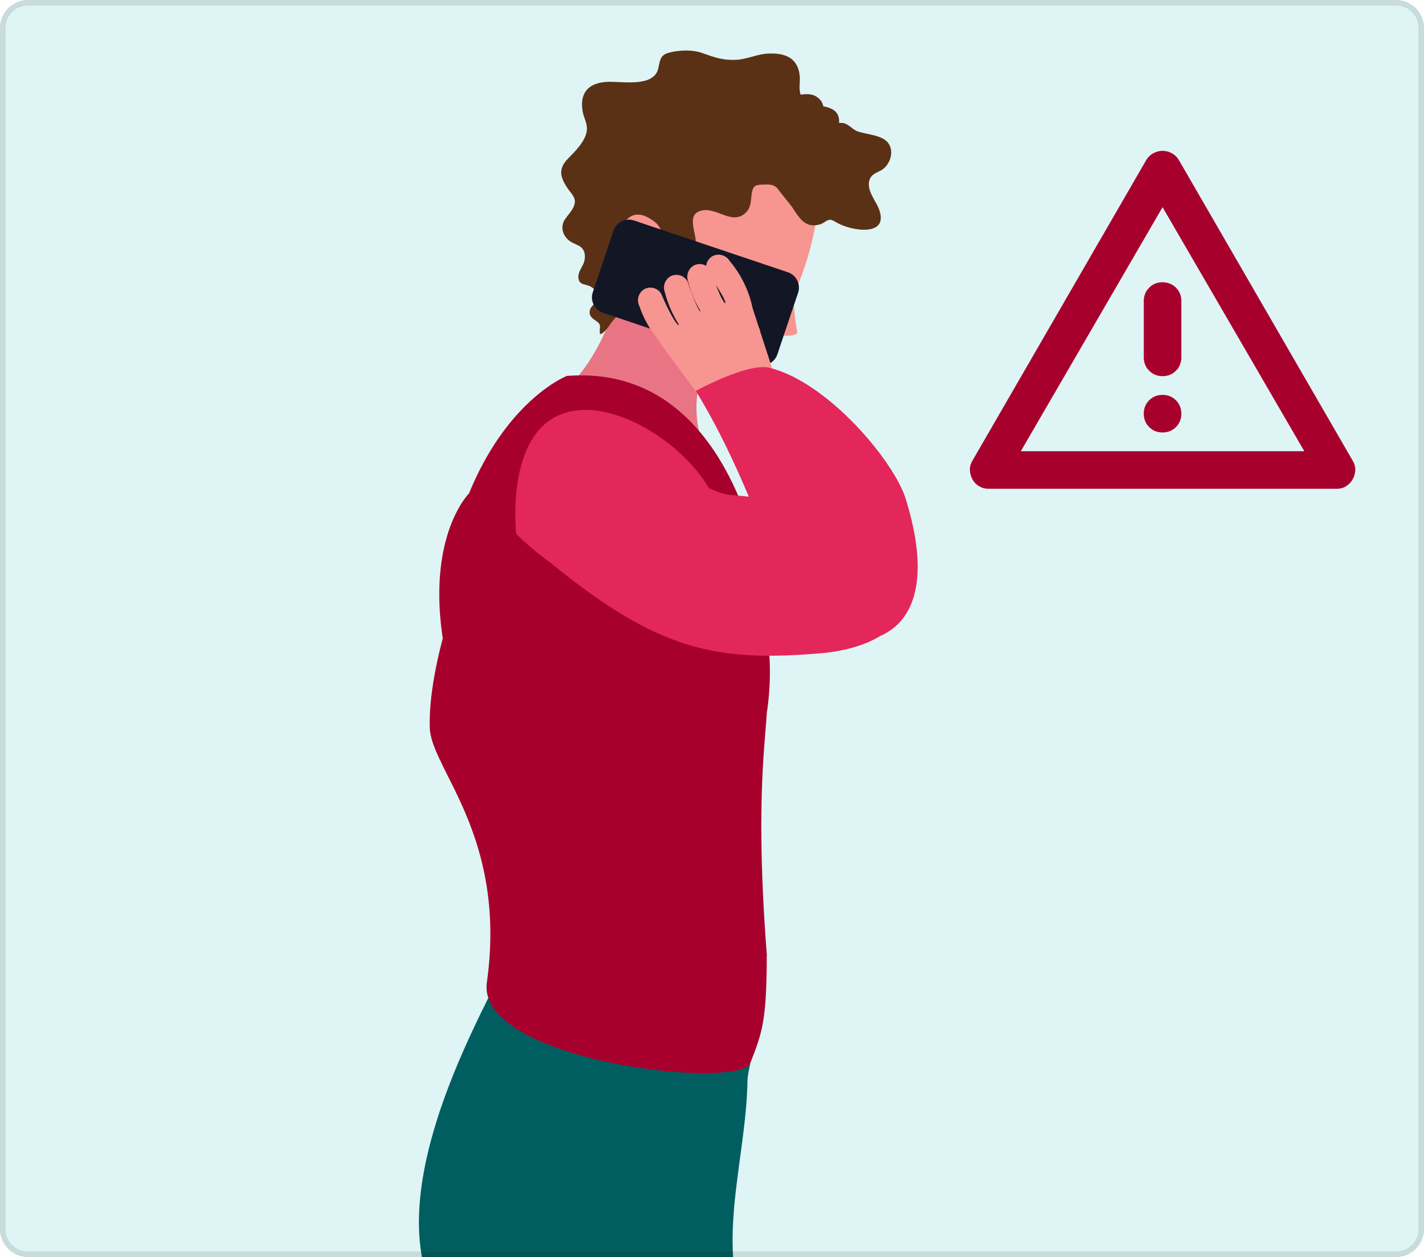
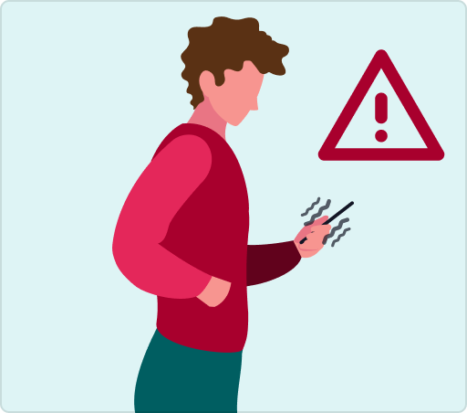
Things to avoid when walking an indoor Waymap route
To achieve success during navigation, we recommend that the following actions are avoided.
Phone by your side
Phone up near face
Too much or too little movement
During navigation, if the phone is held down by the hips, navigation could be inaccurate.
During navigation, if the phone is held up near the face, navigation could also be inaccurate.
During navigation, if there is excessive movement, or the natural walking motion is cushioned from the device, navigation could also be inaccurate.

Slide 13

How it Improves Over Time
When you use Waymap, your journey improves with every step. The app learns how you move to make navigation smarter and more personalised over time.
Why this matters
Waymap adapts to your walking style over time, without the need for calibration. Its intelligent algorithms work behind the scenes, ensuring accuracy improves the more you use it.

Slide 14
Using Waymap for Outdoor Navigation
Waymap guides you outdoors using GPS and advanced routing algorithms. Your location and instructions update as you move. Stick to pedestrian paths and sidewalks and use designated crossings. Stay cautious of traffic and remember to look after your own safety as you move around. Waymap isn't intended as a safety tool. Skip to Next Stage – If available, you can manually advance to the next navigation stage (see next slide for details).
14

Slide 15
Journey Transitions
Many journeys have multiple legs, such as moving between outdoor and indoor navigation or switching transport modes.
Skip to Next Leg – If needed, manually advance to the next stage. Continue Navigation – Follow detailed instructions for a smooth transition. When ready, select ‘Continue Navigation’ to proceed.
15

Slide 16
Thank You
www.waymapnav.com
feedback@waymapnav.com

